Slide 1
Missing Value Treatment

Slide 2
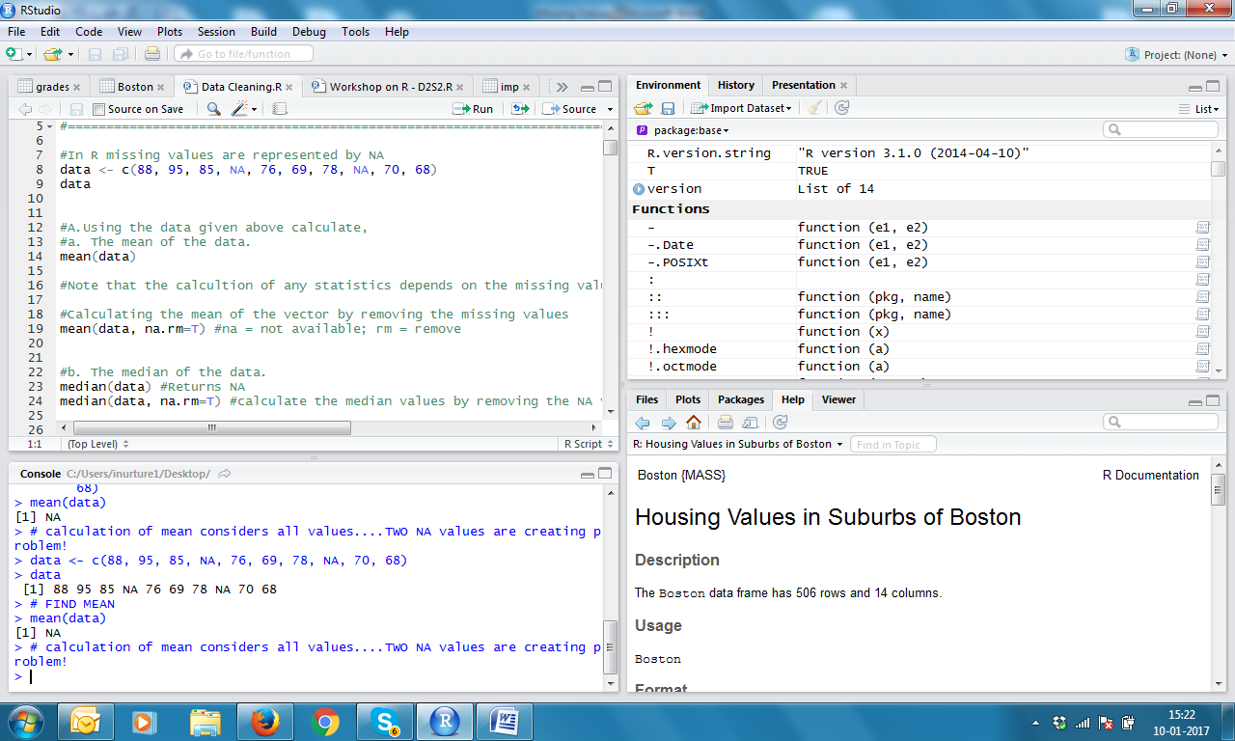
Lets create a vector name data having two NA values

Slide 3
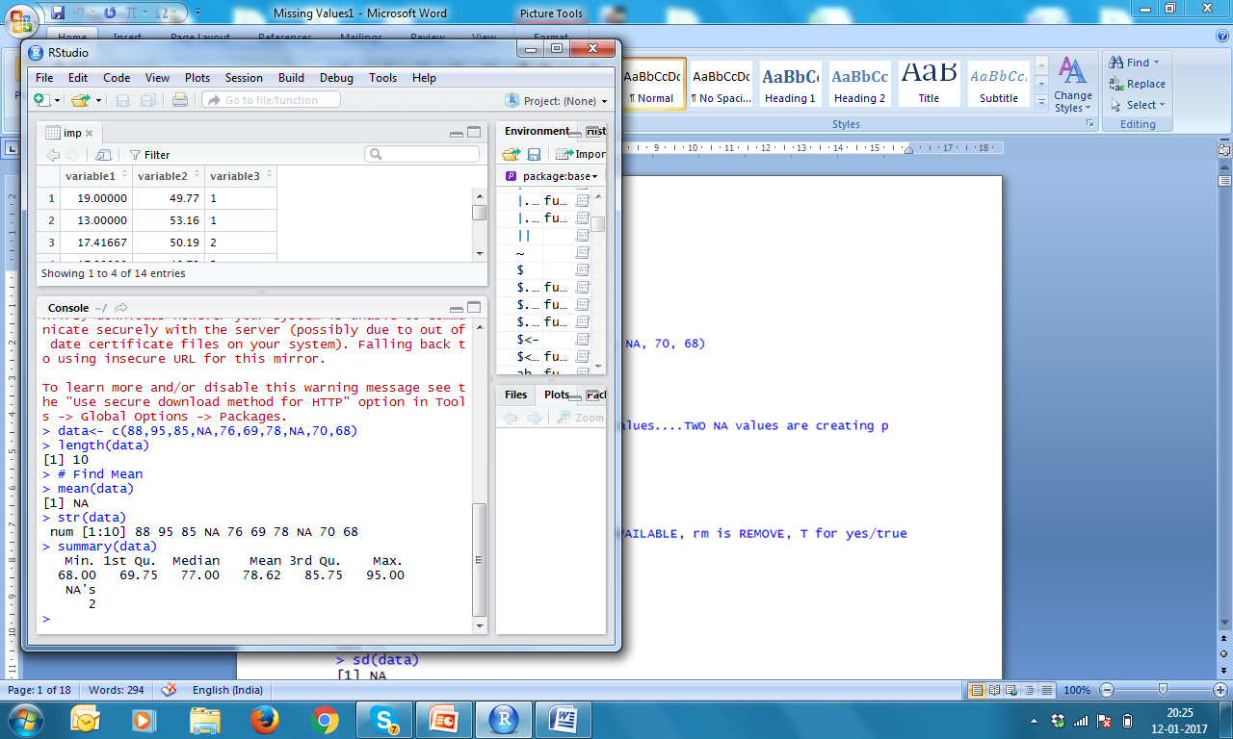
How many Missing Values?

Slide 4
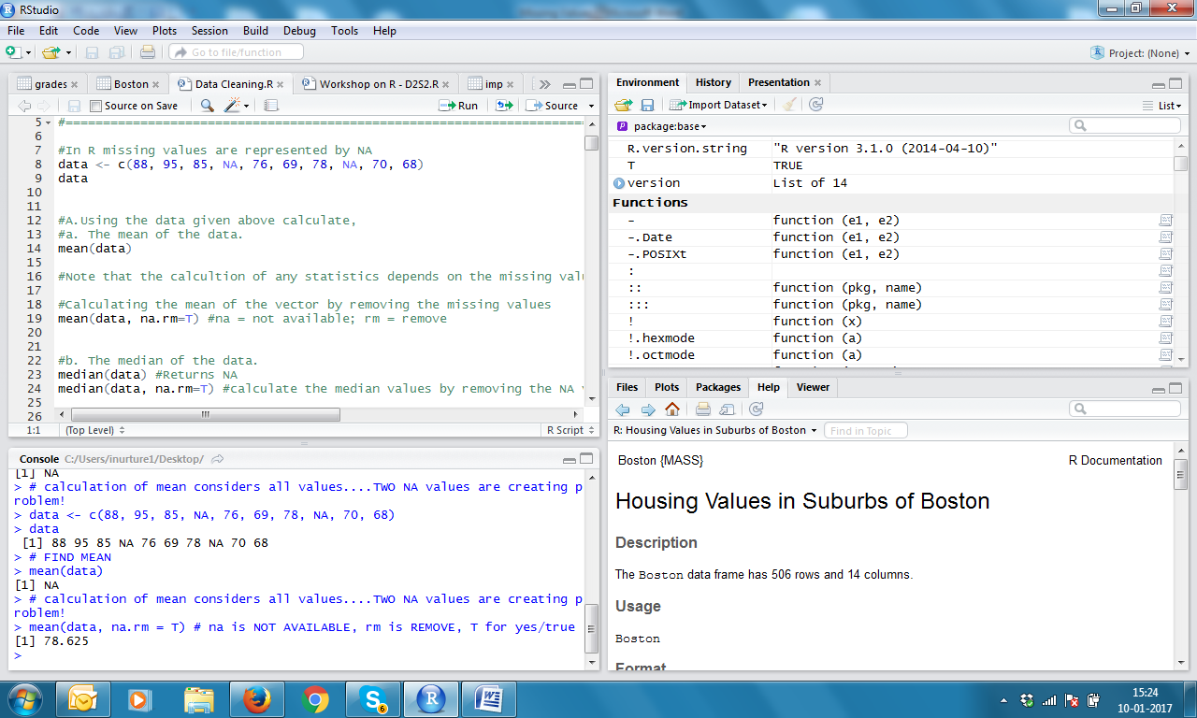
If, we write na.rm = T, calculation of mean will not consider NA values

Slide 5
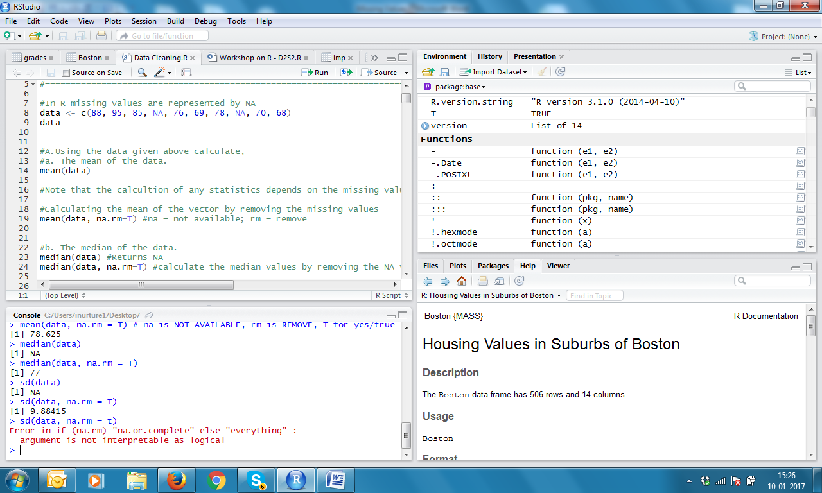
Similarly, we can use na.rm = T for median and standard deviation

Slide 6
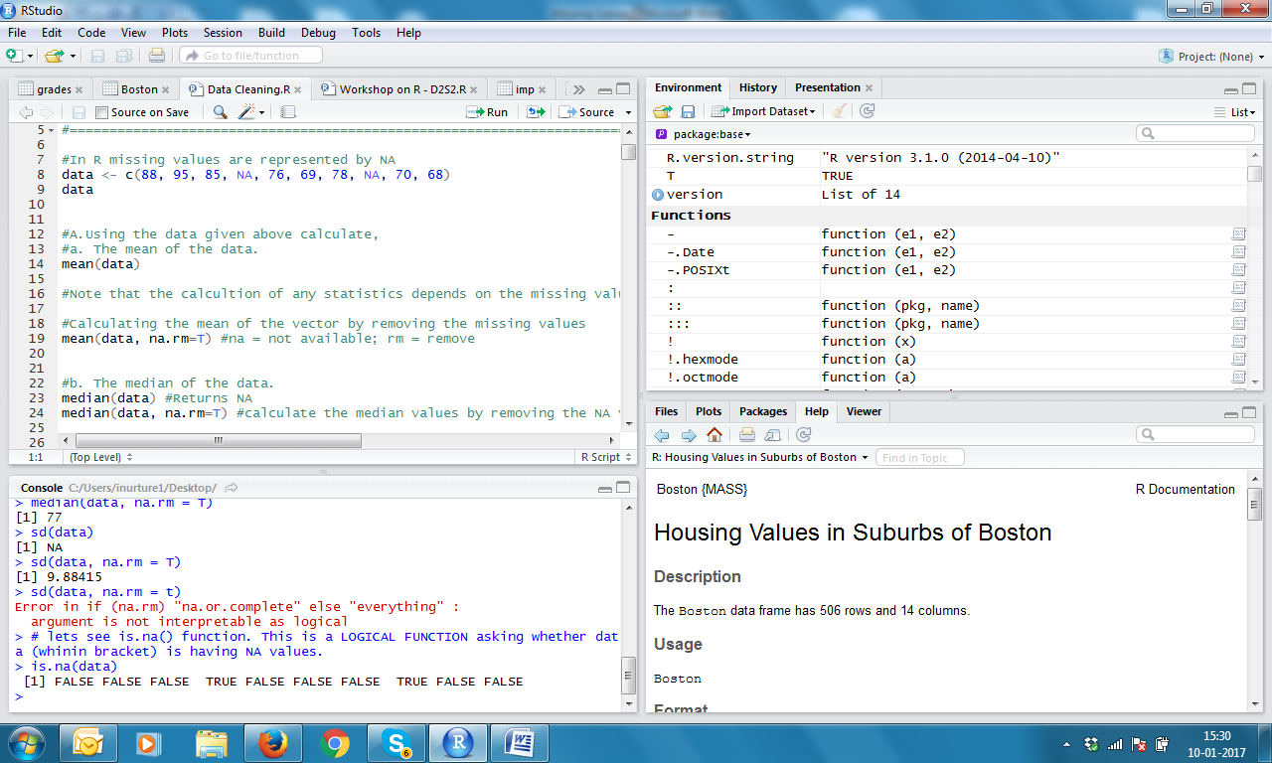
Use of is.na(data) for identifying NA values: TRUE stands for NA value

Slide 7
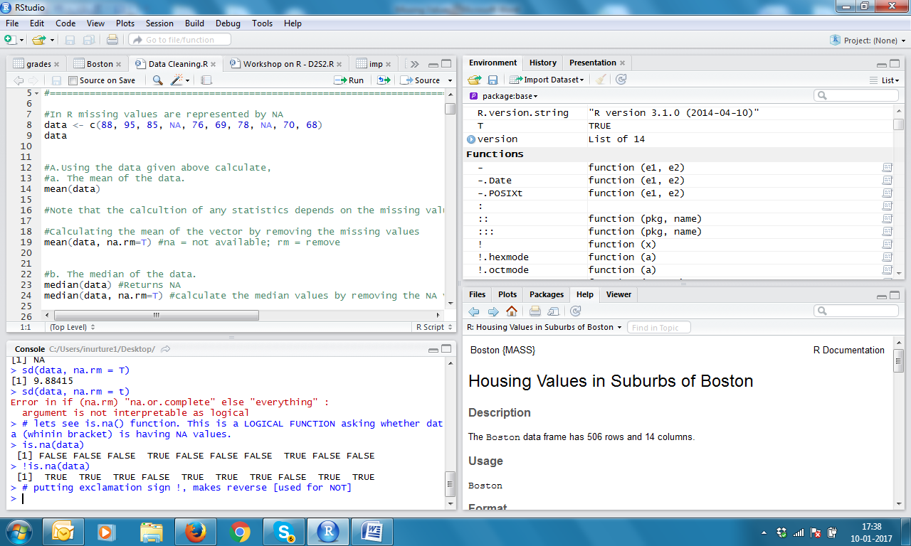
Putting an exclamation sign before argument, reverse the meaning

Slide 8
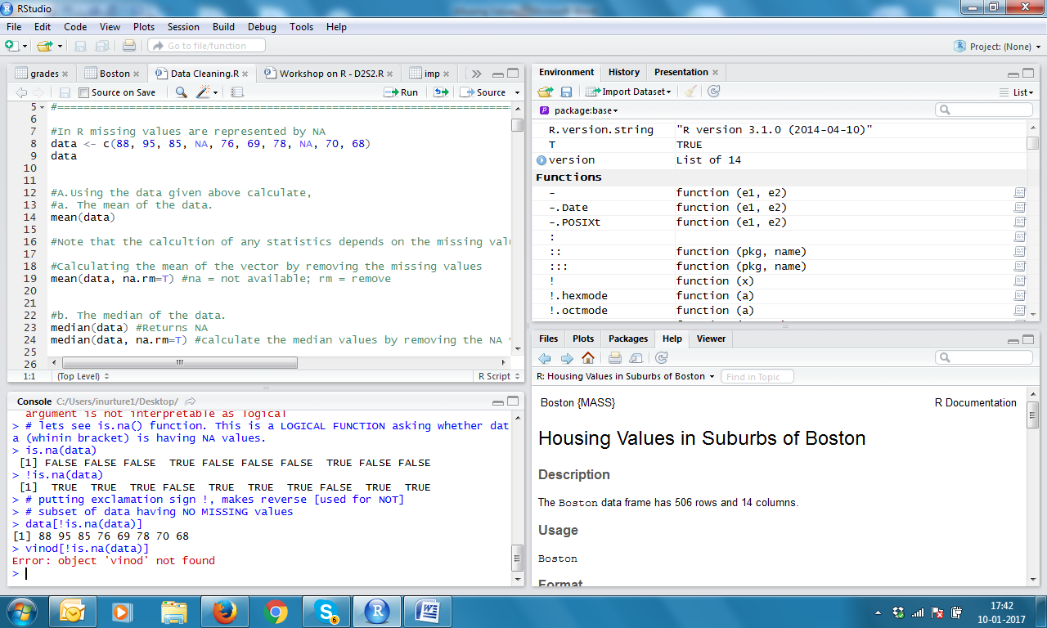
Using is.na concept for finding MEAN Rectangle brackets always used for sub-setting. Exclamatory sign ! Makes data WITHOUT missing values

Slide 9
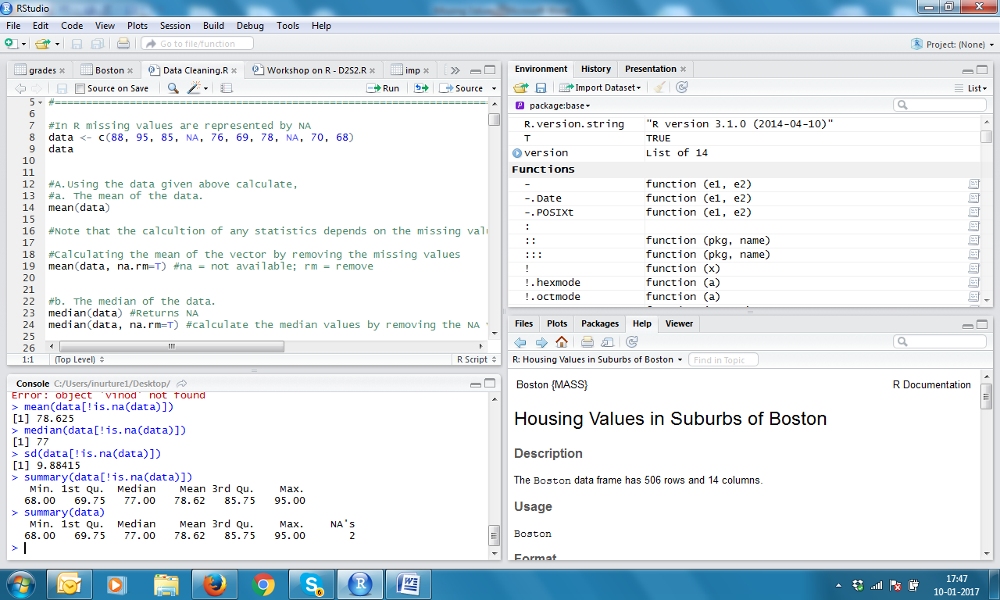
Find Mean, Median, SD, Summary summary (data) will show NA values also

Slide 10
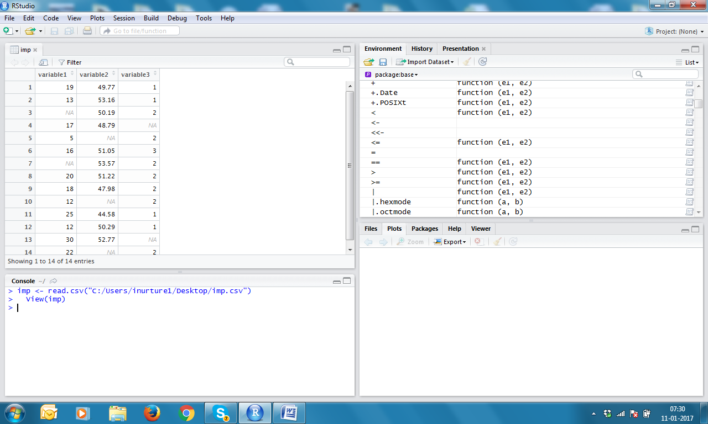
Now lets see a data frame imp.csv

Slide 11
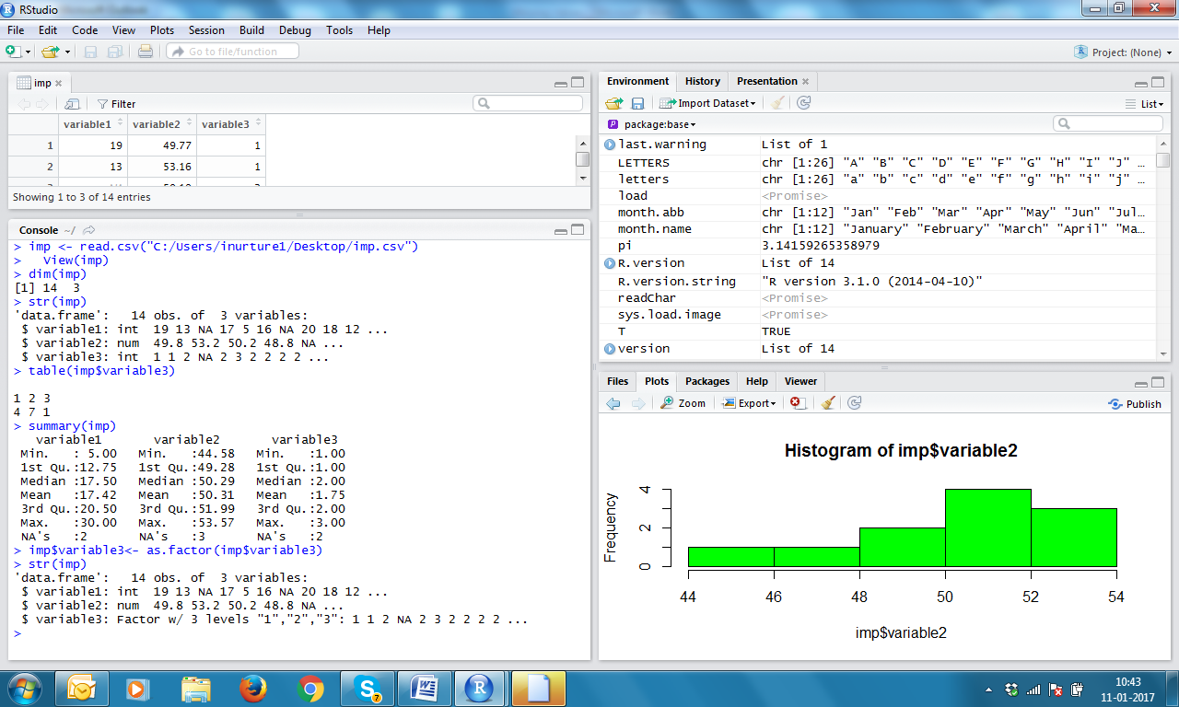
See use of dim(imp) and str(imp)

Slide 12
Summary of imp

Slide 13
Let us attempt Categorical variable3 first

Slide 14
For categorical variable3, Min, Q1, Median, Q3, Max is irrelevant. We need to change from Integer to Factor

Slide 15
See use of as.factor

Slide 16
There are 14 observations, 2 are NAs Which number should come as replacement for NA?
12

Slide 17
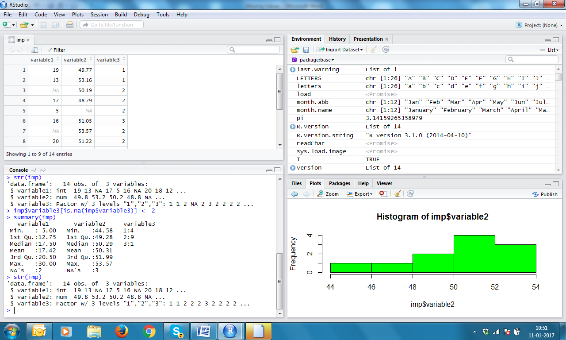
Replace NA by 2
14

Slide 18
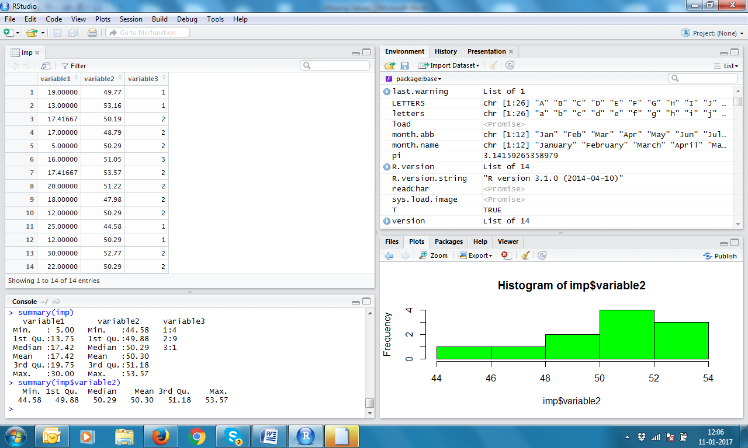
NA replaced by 2

Slide 19
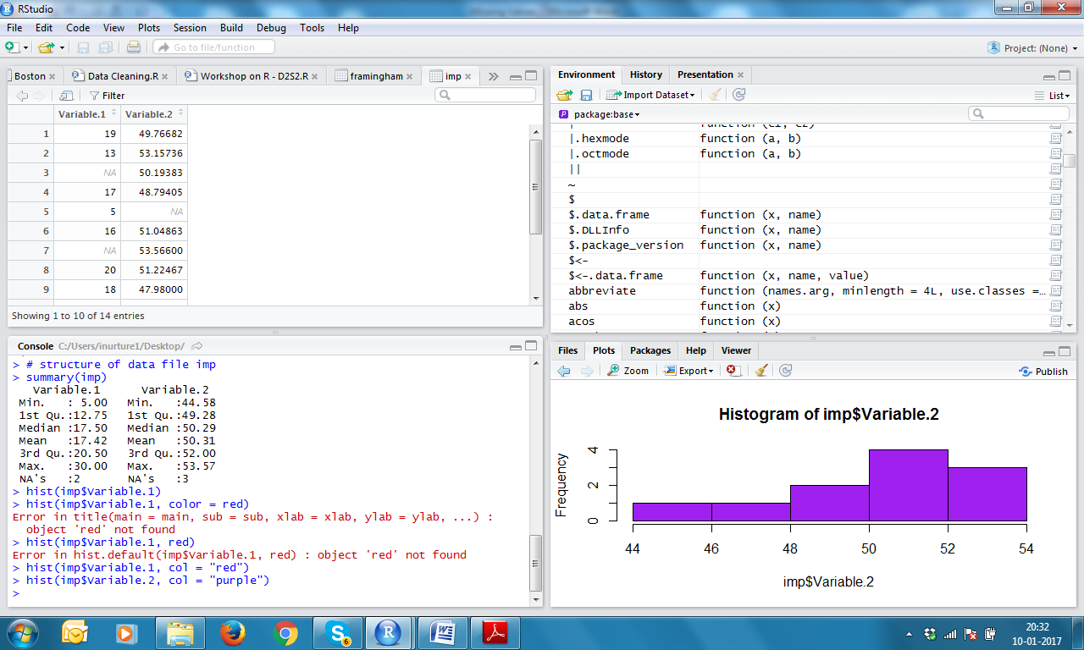
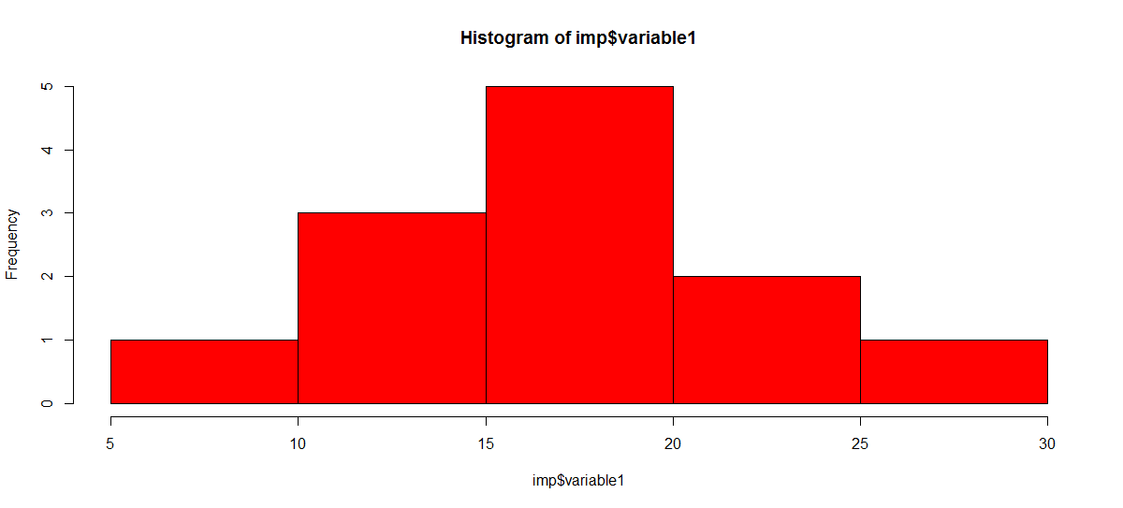
Now let us impute variable1

Slide 20
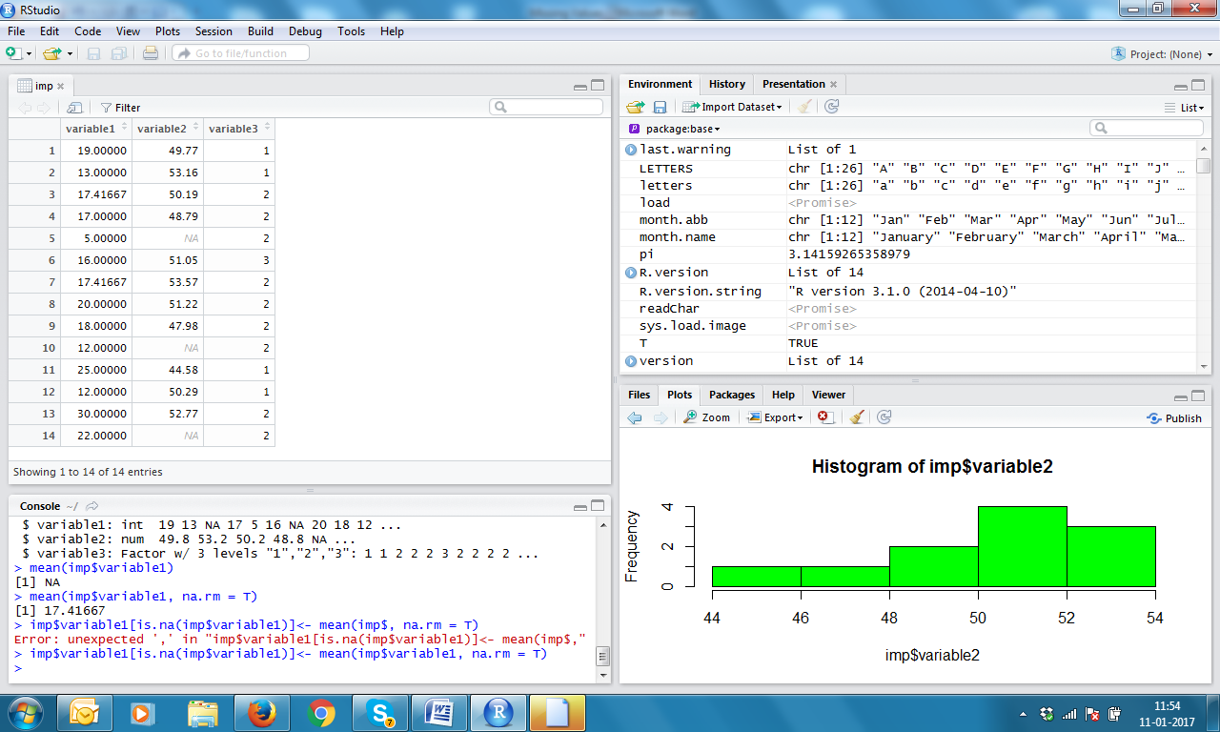
Impute variable1 by MEAN

Slide 21
See 3rd and 7th NA values are MEAN now

Slide 22
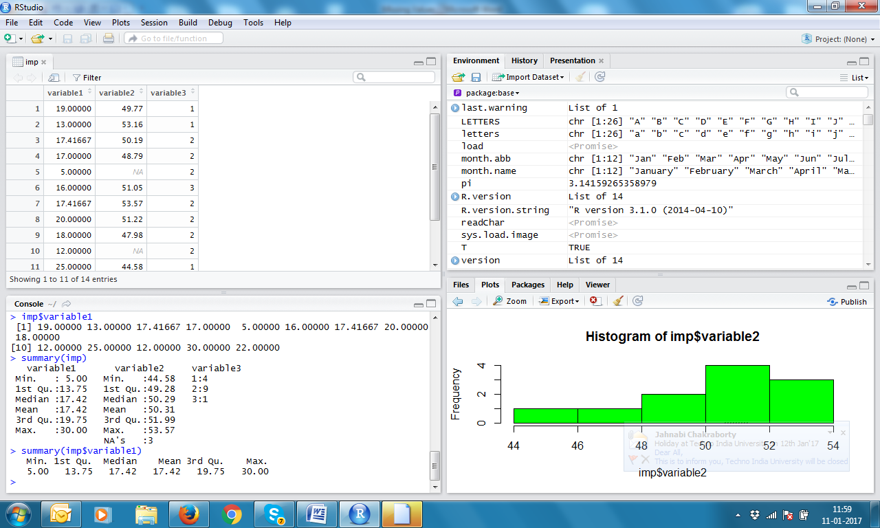
See in summary NA disappears

Slide 23
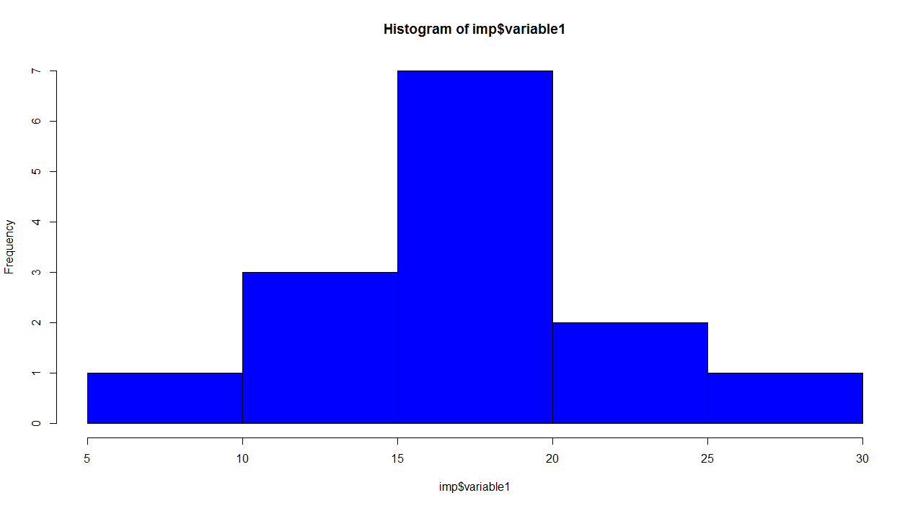
Histograms Can you observe the difference?
Before Imputation
After Imputation

Slide 24
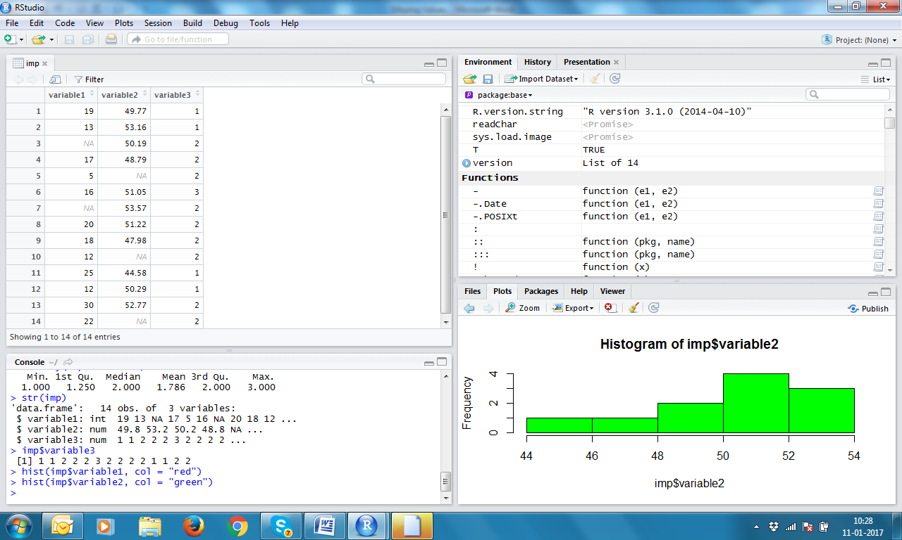
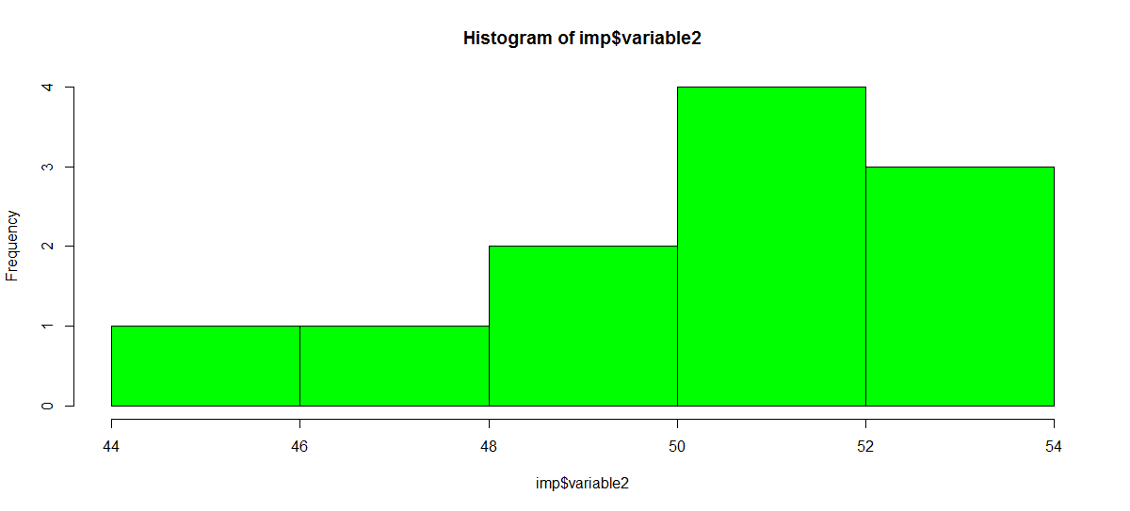
Now let us impute variable2

Slide 25
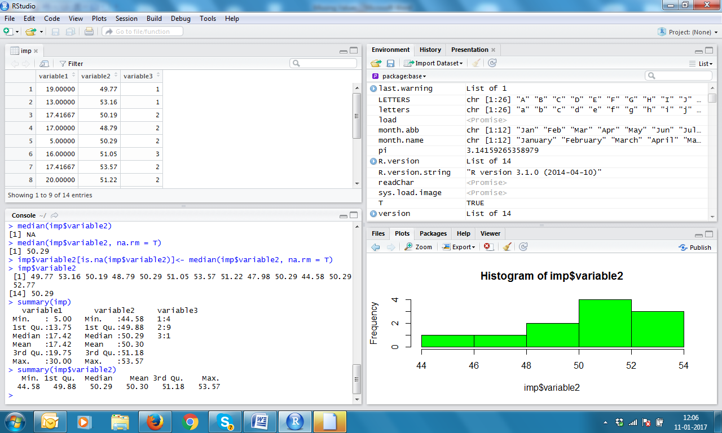
Impute by MEDIAN

Slide 26
NA replaced by MEDIAN

Slide 27
Summary of variable2

Slide 28
KNN Imputation
 | Height | Weight | Gender
1 | 150 | 52 | F
2 | 137 | 45 | F
3 | 135 | 42 | F
4 | 142 | 50 | F
5 | 145 | 51 | F
6 | 160 | 65 | M
7 | 167 | 72 | M
8 | 170 | 75 | M
9 | 162 | 68 | M
10 | 165 | 66 | M

Slide 29
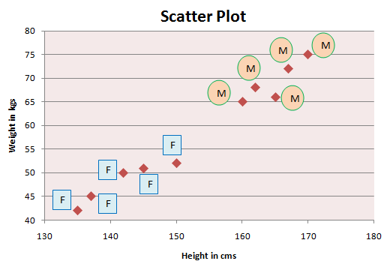
Scatter Plot of Weight vs Height

Slide 30
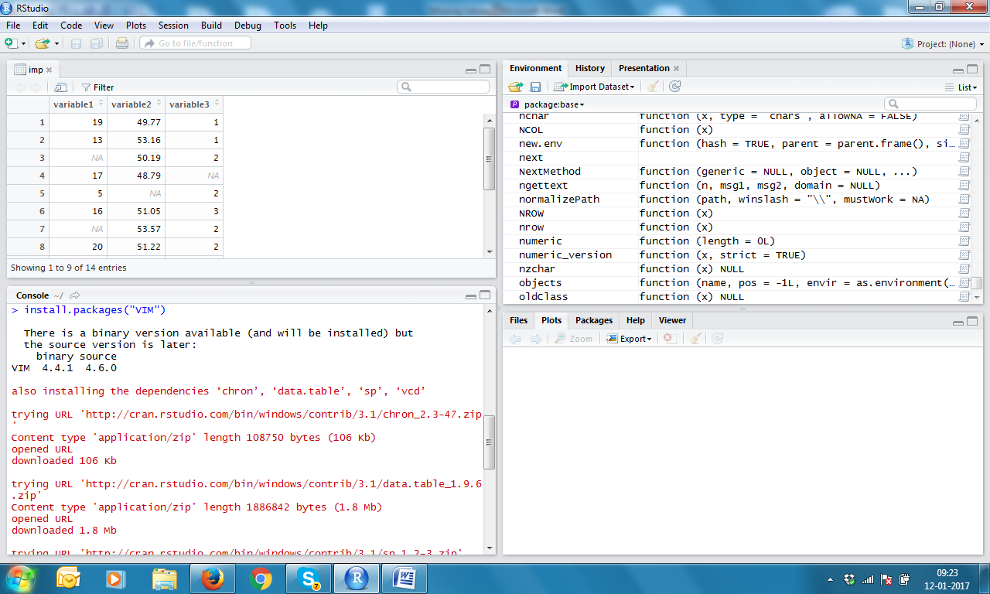
Install packages VIM

Slide 31
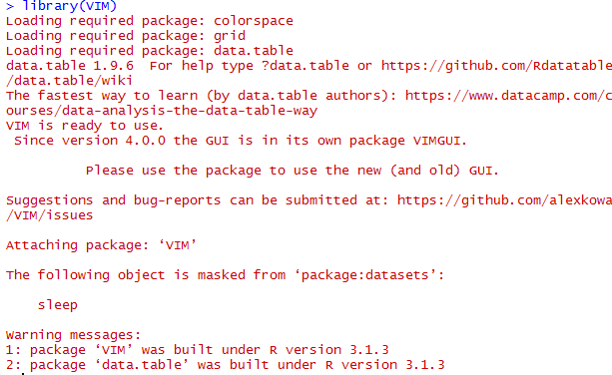
library(VIM)

Slide 32
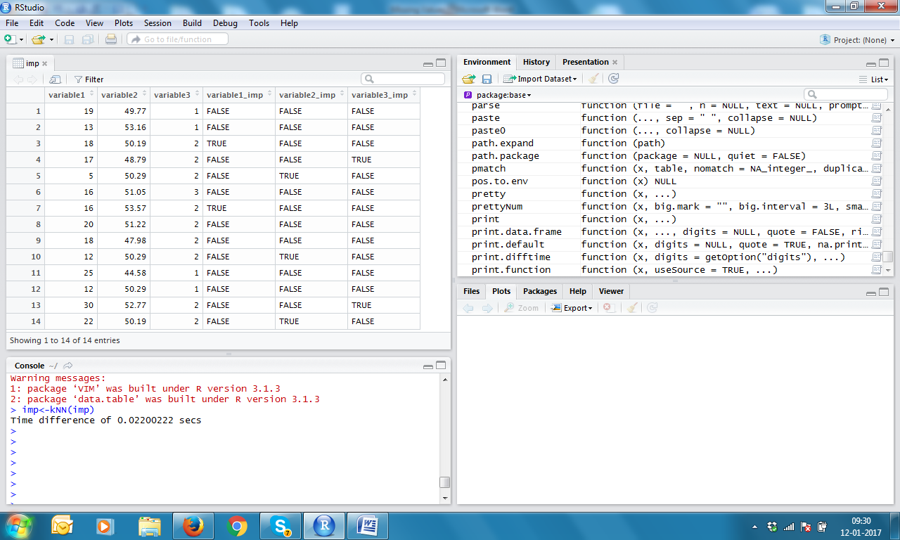
imp<-kNN(imp)
TRUE implies NA value

Slide 33
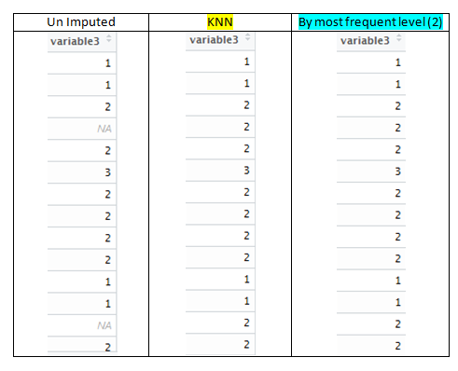
KNN Imputation Variable 3

Slide 34
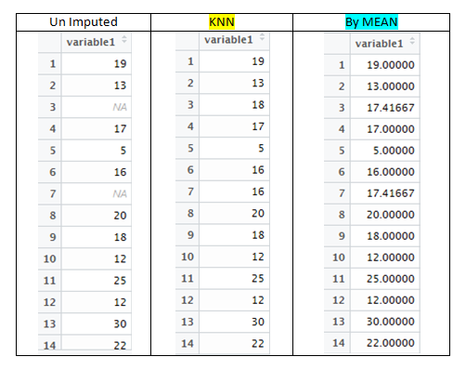
KNN Imputation Variable 1

Slide 35
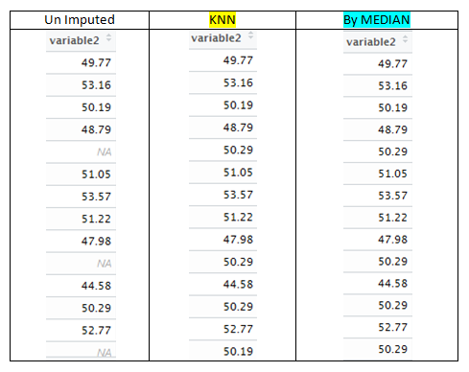
KNN Imputation Variable 2

Slide 36
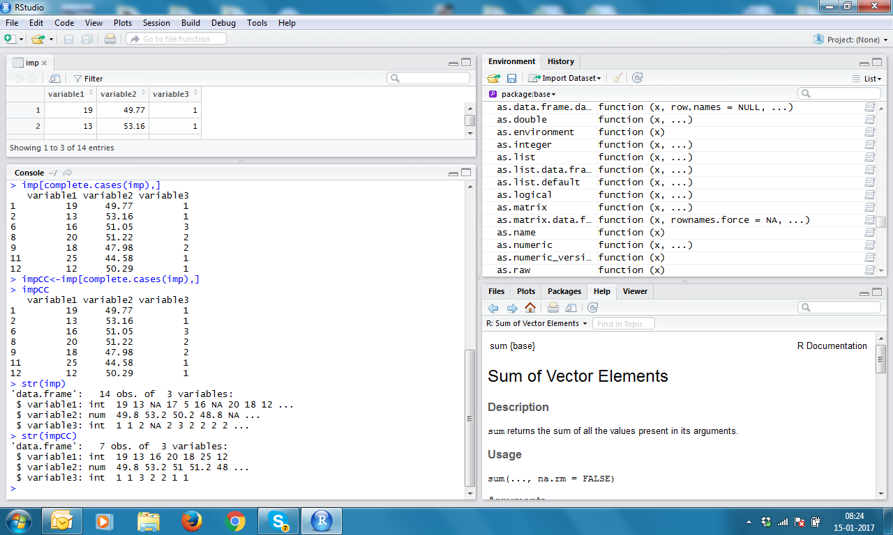
imp[complete.cases(imp), ] Finding Complete cases

Slide 37
See structures

Slide 38
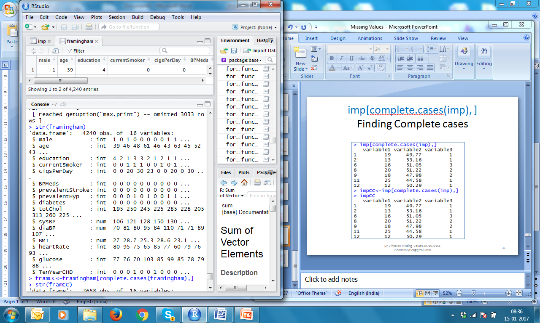
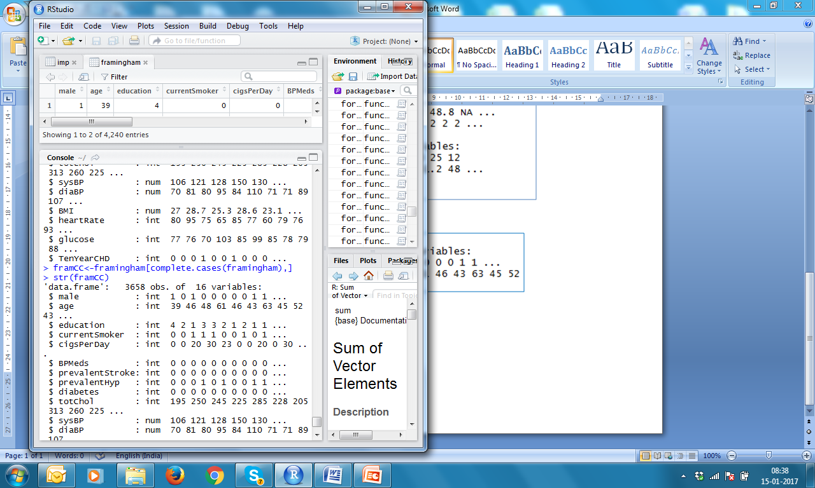
Complete Cases of framingham data

